Slide 1
Clustering and Partitioning for 3D ICs architectures
Research progress committee
September 2018

Slide 2
IC industry in turmoil
Moore’s Law is fine, but need to palliate Rock’s
“GF Puts 7nm On Hold”
How to enable 3D integration for existing 2D architectures?
Notes:
https://semiengineering.com/gf-puts-7nm-on-hold/
GF met le 7nm de côté pour se concentrer sur le 12/14nm. C’est l’un des quatre grand fab qui était encore dans la course. Il en reste maintenant plus que Intel, Samsung et TSMC. AMD va d’ailleurs se tourner vers TSMC pour les techno bleeding edge, mais rester chez GF pour le 12nm. GF va en plus en profiter pour développer les pistes 2.5D et 3D.

Slide 3
3D to save the day
Shorten the connections by bringing the gates closer to each other
→ Better timing and performance
→ Less power
→ Lower buffer usage
Notes:
Is there a way to tell if a design is fit to go 3D, just based on a preliminary analysis?
The problem is twofold:
Partitioning
Clustering
Reduce wirelength by bringing the gates closer to each other.

Slide 4
3D is not trivial
How to deal with thermal hot spots?
How to plan the TSVs interconnecting the layers?
How to optimize the manufacturing?
Clock tree and PDN synthesis
How to decide which block goes where?

Slide 5
Mainly two challenges
Clustering
How do we avoid to cut short nets?
What is a ‘good’ clustering method?
Is there an optimal grain?
Partitioning
How do we decide where goes each block?
Should we do MIN- or MAX-cut?

Slide 6
But there are more
How to interface with a 2D toolchain?
What is the best way to use 2D info for a 3D design?
What is the optimal level of integration?

Slide 7
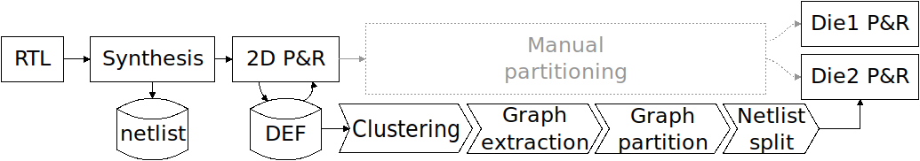

Recent work overview

Slide 8
2017-2018
New designs: LDPC 4x4 (serial, fully connected)
New clustering methods
Random
Using partitioning
Progressive wire-length
Hierarchical geometric
MAX-cut (circut)
Arbitrary partitioning
Performance improvement

Slide 9
Additional designs
 | Gates | Nets | WL [µm] | Area [µm²]
LDPC | 42,471 | 49,633 | 173,167 | 3,309
SmallBoom | 121,580 | 137,171 | 308,947 | 10,400
CCX | 185,777 | 200,999 | 5,455,493 | 313,464
Flipr | 220,587 | 234,373 | 767,365 | 14,713
SPC | 289,812 | 306,118 | 10,112,735 | 906,827

Slide 10
Additional designs
 | Gates | Nets | WL [µm] | Area [µm²]
LDPC | 42,471 | 49,633 | 173,167 | 3,309
SmallBoom | 121,580 | 137,171 | 308,947 | 10,400
CCX | 185,777 | 200,999 | 5,455,493 | 313,464
Flipr | 220,587 | 234,373 | 767,365 | 14,713
SPC | 289,812 | 306,118 | 10,112,735 | 906,827
LDPC 4x4 Serial | 694,082 | 773,679 | 6,023,683 | 57,085
LDPC 4x4 | 808,199 | 883,395 | 10,872,106 | 105,682
16 daisy-chained LDPC cores
16 fully interconnected LDPC cores
→ Larger designs with different level of interconnection

Slide 11
Clustering 1: random
Create all clusters first
Dispatch gates following a uniform random variable
→ Reference for more elaborate methods

Slide 12
Clustering 2: using partitioning
Reccursive MIN-cut
Aim: Is a pure MIN-cut finding the same clusters as the 2D workflow?
Let’s see with LDPC 4x4 Serial...
Notes:
Rendu possible grâce aux optimisation d’extraction d’hypergraphe, sinon ça aurait pris trop de temps.

Slide 13
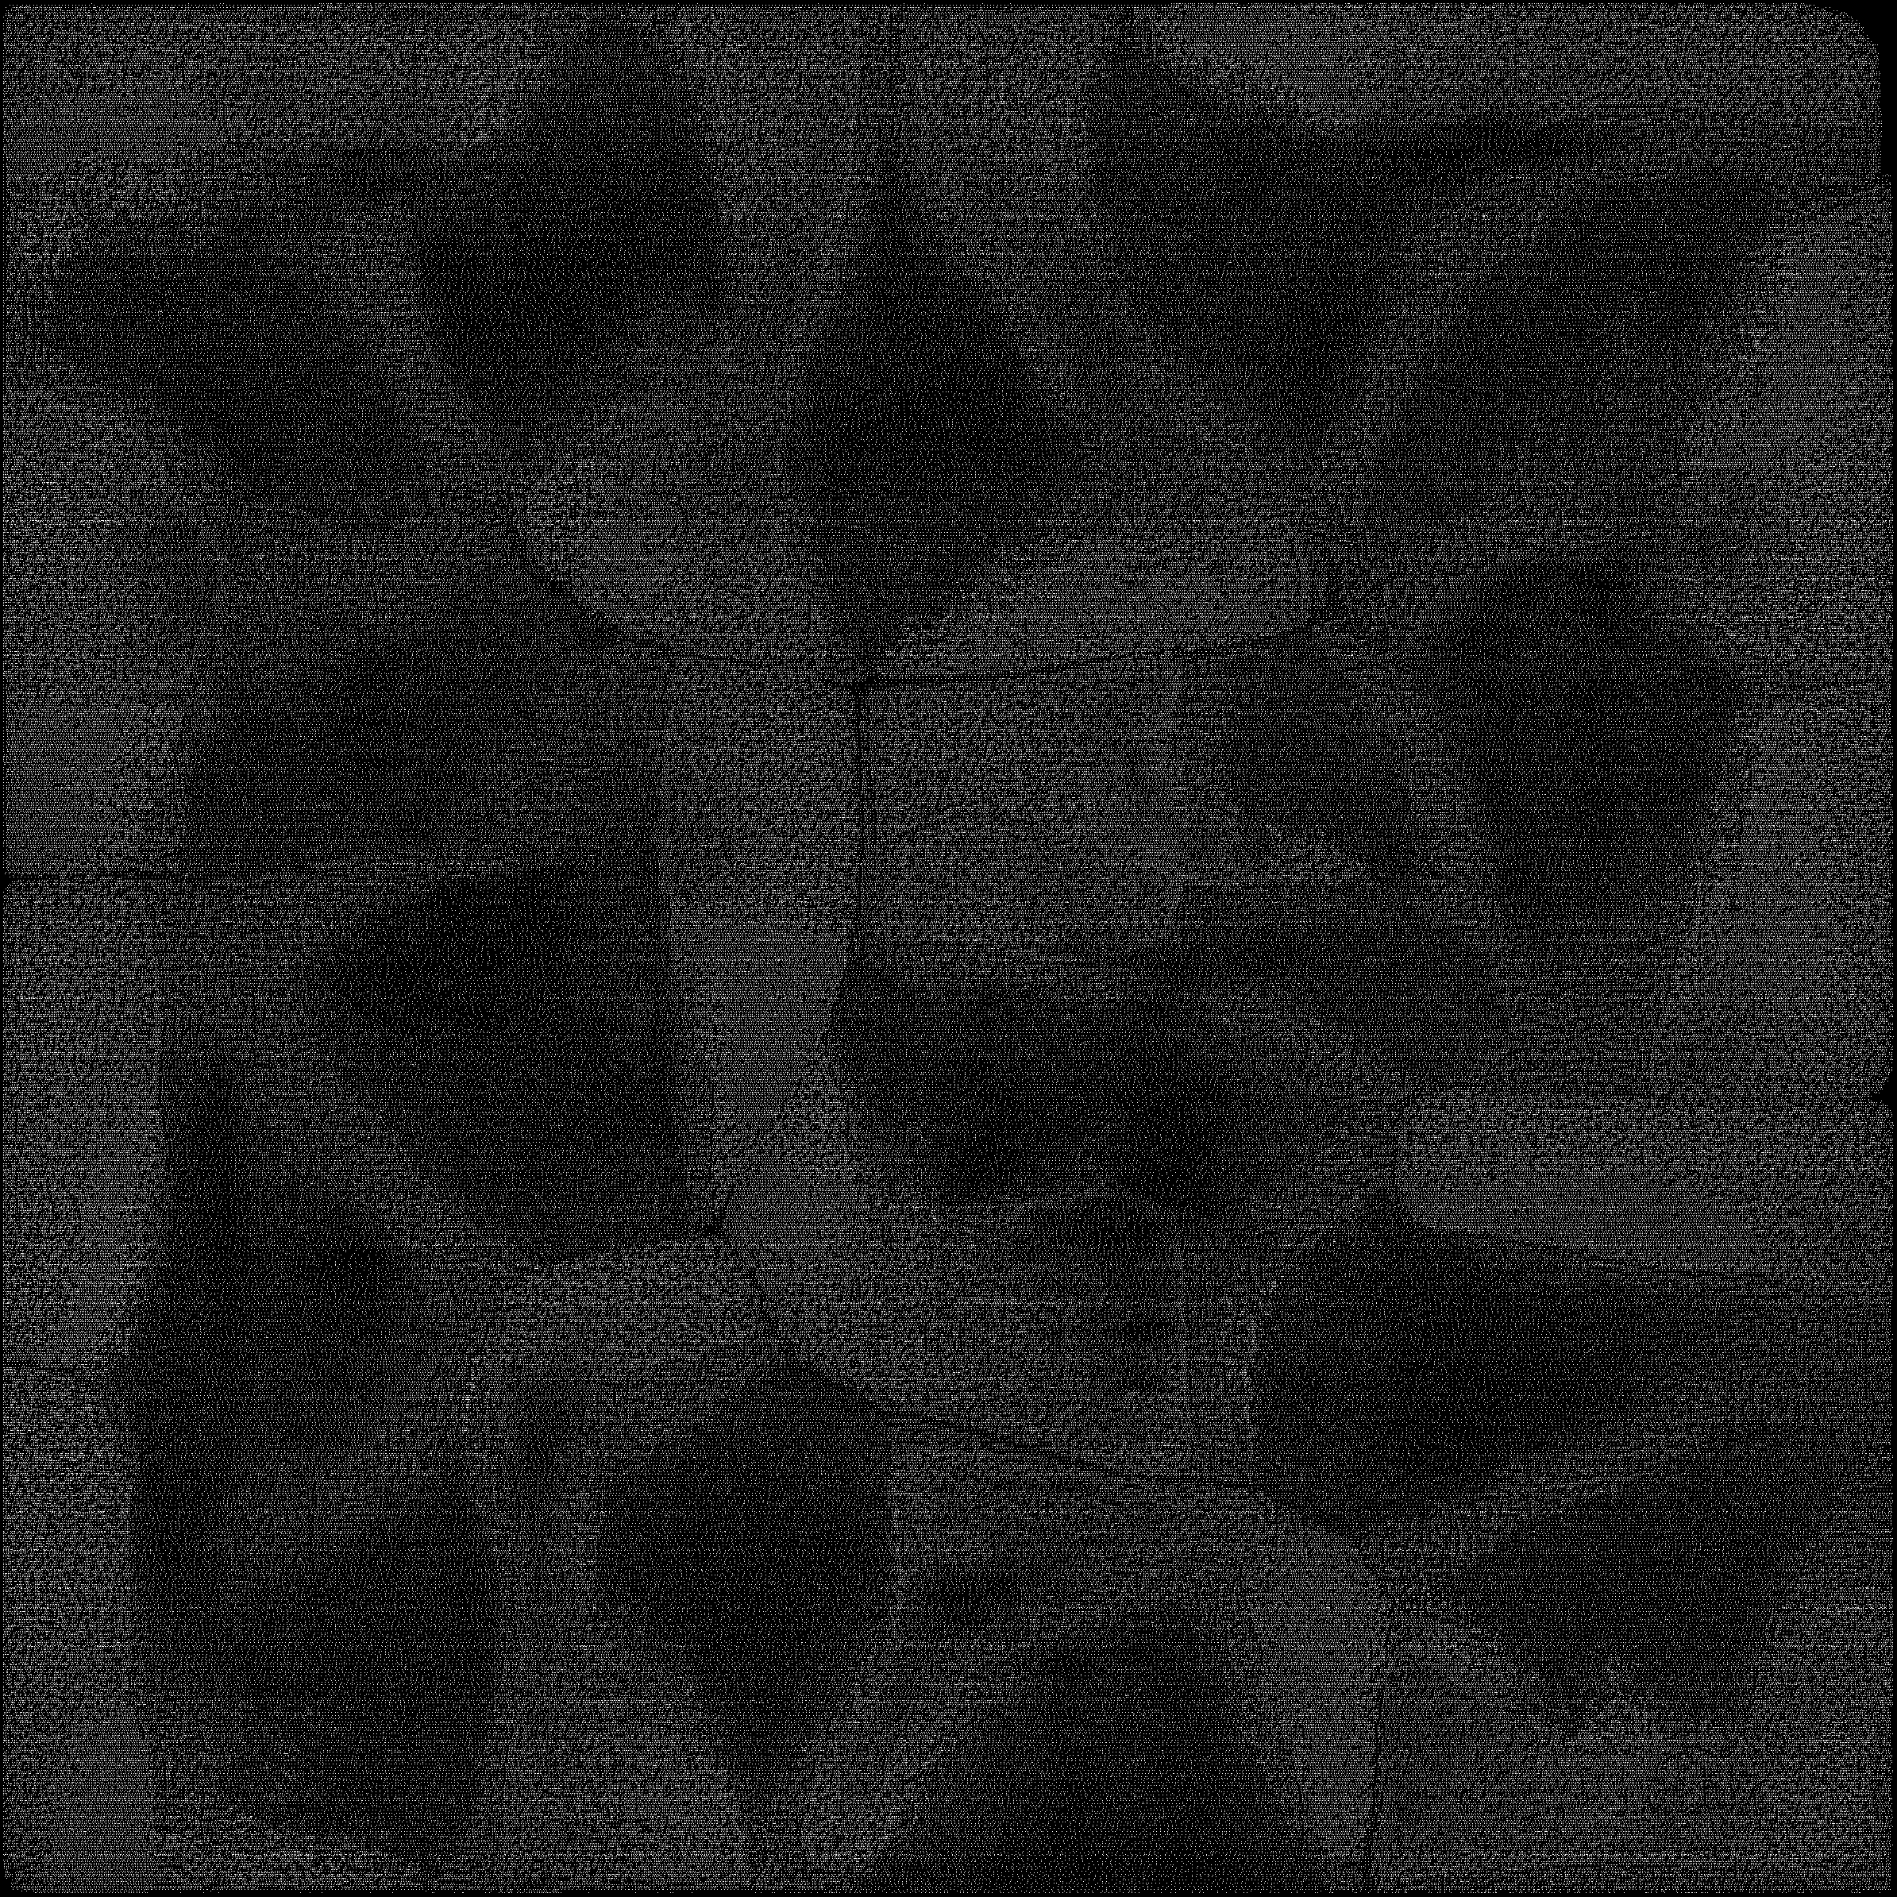

Slide 14
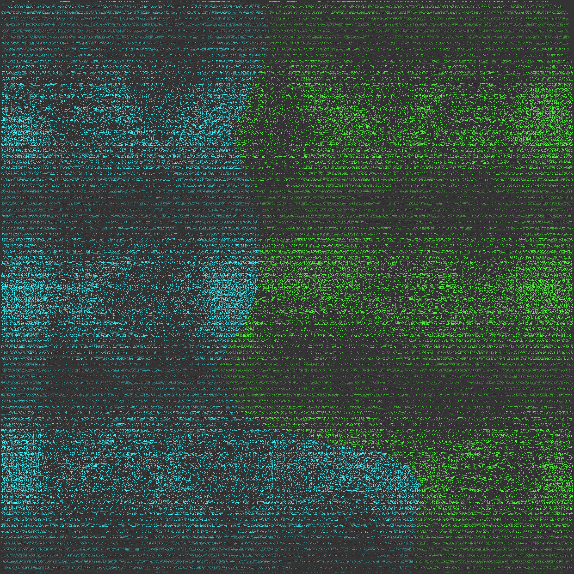

Slide 15
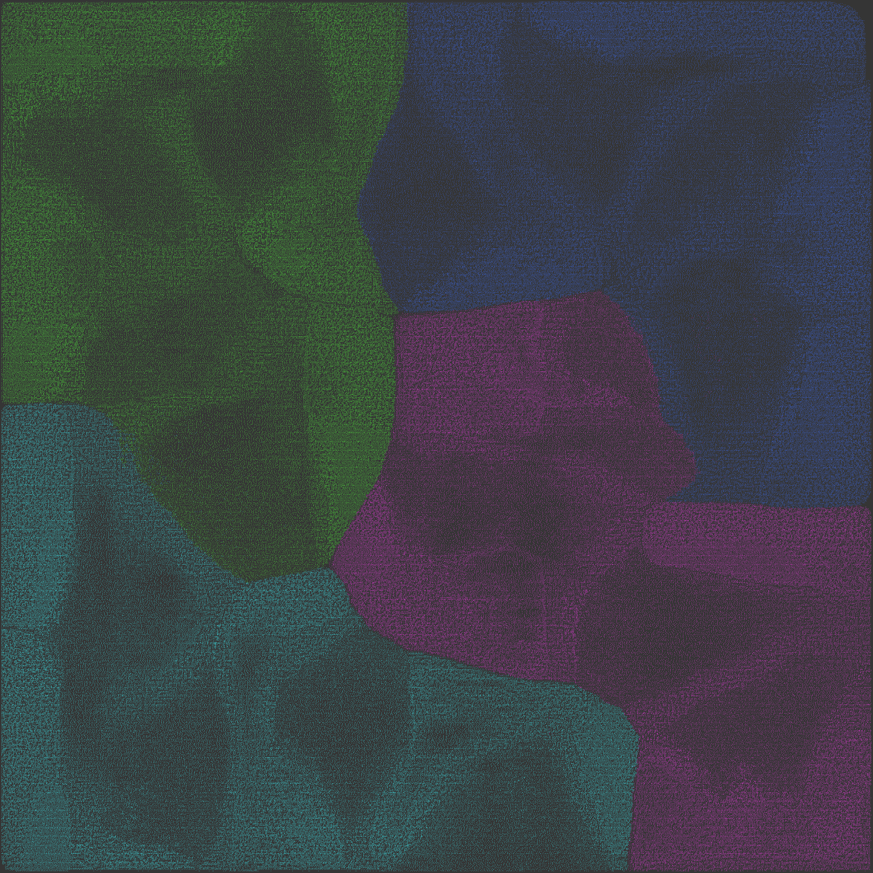

Slide 16
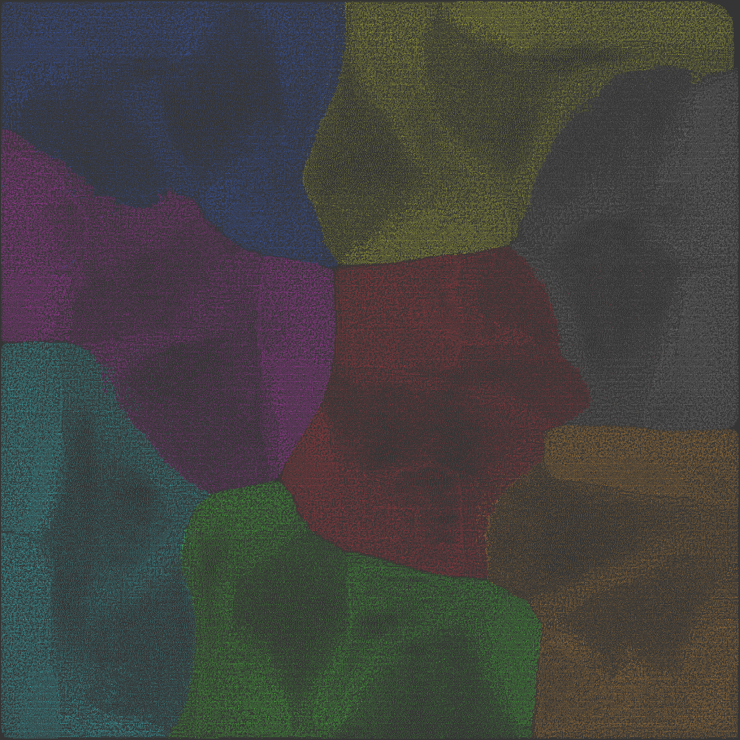

Slide 17
What can we learn?
Clustering grain matters
Clustering method matters
MIN-cut partitioning of a very fine-grain clustering is like running in circle.

Slide 18
Clustering 3: Progressive WL
Create one cluster per gate
Sort nets in ascending order of length
For each net below the threshold:
Merge all clusters connected
Threshold:
Balanced-partitionability (Greedy bin packing problem)
Total amount of clusters
WL threshold (not tested)

Slide 19
Clustering 4: Hierarchical geometric
splitDesign(cluster, power):
clusterList = list()
if power > 0:
if power % 2 == 1: # Vertical
create clusterLeft
clusterList.append(splitDesign(clusterLeft, power-1))
# Same for clusterRight
elif power % 2 == 0: # Horizontal
# Same as vertical
return clusterList

Slide 20
Clustering 4: Hierarchical geometric
Improvement over the naïve geometric clustering
All clusters have the same physical size, but not the same amount of gates (depends on homogeneity of the design)
Only power of 2 amount of clusters

Slide 21
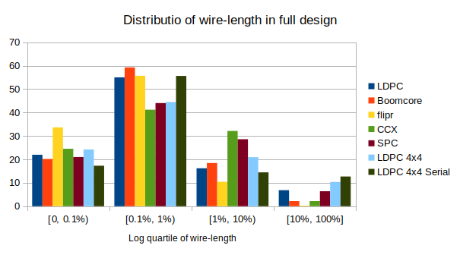
Short wires are abundant

Slide 22
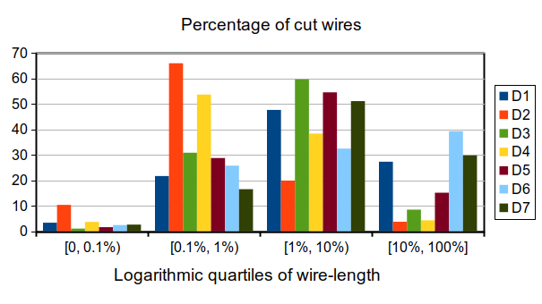
Shortest are hidden

Slide 23
Partitioning: MAX-cut
‘CirCut’: “Rank-Two Relaxation Heuristics for MAX-Cut and Other Binary Quadratic Programs”
Works on graphs → translation from hyper to simple
Fundamental concepts to understand (Goemans and Williamson, 1995): Linear equality constraints, convex-programming, linear programming over cones, relaxation, SDP, etc.

Slide 24
Partitioning: Arbitrary
Arbitrary partitioning: every other cluster goes to every other partition.
Simulates a bad partitioning.

Slide 25
Partitioning comparison
 | MIN-cut | Arbitrary | MAX-cut
LDPC | 1,966 | 14,324 | 18,366
BoomCore | 935 | 39,811 | 49,516
flipr | 3,905 | 75,658 | 93,238
CCX | 2,355 | 66,680 | 83,029
SPC | 2,908 | 104,335 | 118,107
LDPC 4x4 Serial | 5,763 | 172,233 | 207,379
LDPC 4x4 | 18,265 | 206,461 | 255,677
Metric: Number of nets cut
Clustering: Hierarchical geometric
Grain: 2048 clusters

Slide 26
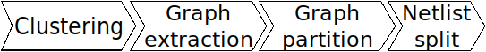
Performance improvement
Notes:
Commits on Mar 14, 2018
Phoney: performance improvement.
@parastuffs
parastuffs committed on Mar 14
When looking at the time spent in phoney, two parts take most of the total time: hyperedge merging and partition directives extraction.
1) Actually, it is not necessary to merge the hyperedges.
Cutting two hyperedges of weight 1 or one hyperedge of weight 2 yields exactly the same result in my analysis.
We can thus simply stop merging the hyperedges and just convert all the nets into hyperedges, except the 'single-instance' nets.
2) The reason why the partition directives extraction took so long is because of the poor choice of data structure for the clusters.
I simply had some list of the clusters ID. It's actually *way* more efficient to use a dictionary, especially when I want to find a particular cluster based on its name.
The side effect of switching to a dictionary is that the clusters reading in the graph building phase is also way quicker, becoming virtually instantaneous.
For example: LDPC with one gate per cluster took 1h16m with the original script, close to 1h without the hyperedges merging and only *4m* with the dictionary.
When partitioning all clustering levels of LDPC random, I went from 3h16m to only 14m, *14 times faster*.
Yep, that's a mission well done.
I already gained a 10x factor back in July 2017: 493fb6a.

Slide 27
Performance improvement
Phoney: Graph extraction and partitioning
Two main time-consuming parts:
Hyperedge merger
Partition directives extraction
Notes:
Commits on Mar 14, 2018
Phoney: performance improvement.
@parastuffs
parastuffs committed on Mar 14
When looking at the time spent in phoney, two parts take most of the total time: hyperedge merging and partition directives extraction.
1) Actually, it is not necessary to merge the hyperedges.
Cutting two hyperedges of weight 1 or one hyperedge of weight 2 yields exactly the same result in my analysis.
We can thus simply stop merging the hyperedges and just convert all the nets into hyperedges, except the 'single-instance' nets.
2) The reason why the partition directives extraction took so long is because of the poor choice of data structure for the clusters.
I simply had some list of the clusters ID. It's actually *way* more efficient to use a dictionary, especially when I want to find a particular cluster based on its name.
The side effect of switching to a dictionary is that the clusters reading in the graph building phase is also way quicker, becoming virtually instantaneous.
For example: LDPC with one gate per cluster took 1h16m with the original script, close to 1h without the hyperedges merging and only *4m* with the dictionary.
When partitioning all clustering levels of LDPC random, I went from 3h16m to only 14m, *14 times faster*.
Yep, that's a mission well done.
I already gained a 10x factor back in July 2017: 493fb6a.

Slide 28
Hyperedge merger
Merge identical hyperedges and sum their weights
→ Just don’t!
1 hyperedge of weight n is the same as n hyperedges of weight 1 in my case.

Slide 29
Partition directives extraction
Data structure matters
Use a dictionnary instead of a list

Slide 30
Example: LDPC, 1-to-1
Notes:
For example: LDPC with one gate per cluster took 1h16m with the original script, close to 1h without the hyperedges merging and only *4m* with the dictionary.

Slide 31
Communications
Fosdem 2018 (Open hardware dev room)
ICECS 2018

Slide 32
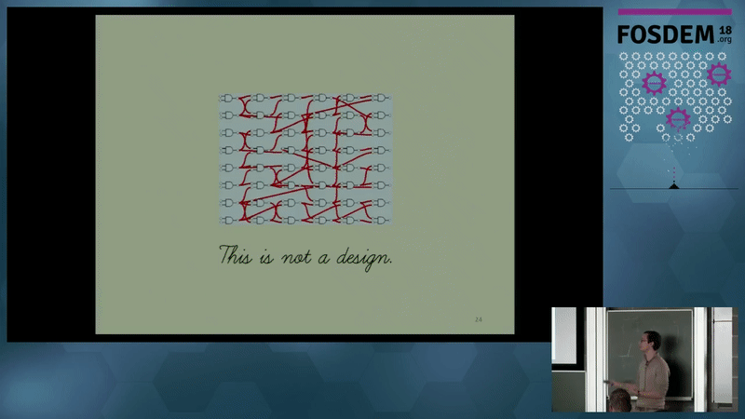
Notes:
https://archive.fosdem.org/2018/schedule/event/cad_3d_asic/
25 minutes talk in February 2018
Show a summary slide of the talk.

Slide 33
ICECS 2018
“3D-Stacked Integrated Circuits: How Fine Should System Partitioning Be?”
Submitted on July 15th
Notification of acceptance September 20th
Venue: December 10th to 12th, Bordeaux
Notes:
25th IEEE International Conference on Electronics Circuits and Systems

Slide 34
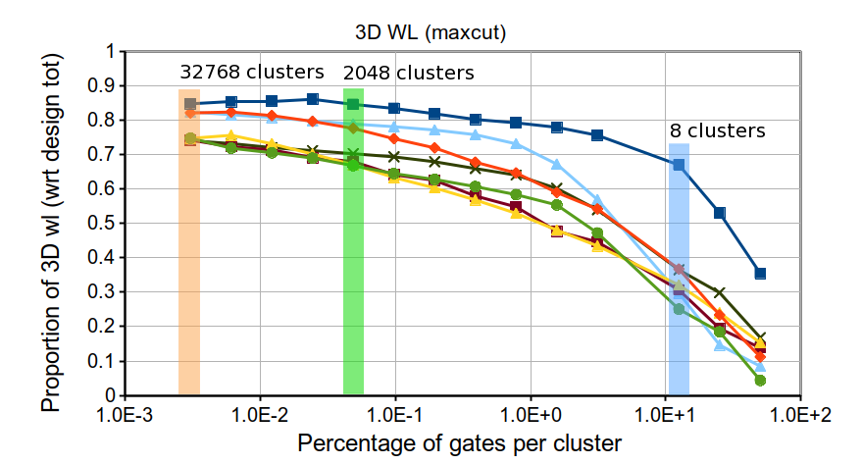
An optimal clustering grain exists

Slide 35
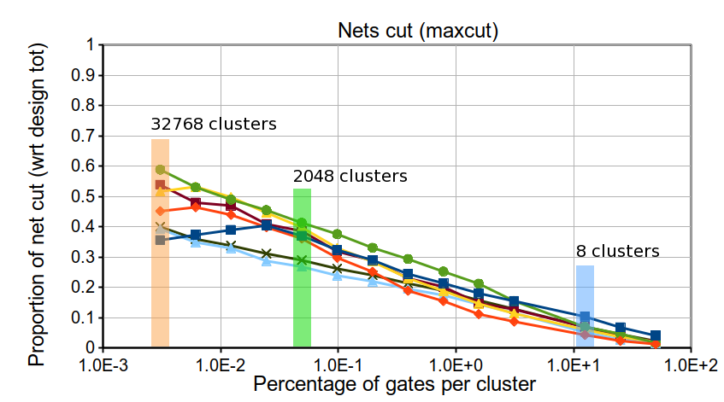
An optimal clustering grain exists

Slide 36
Planning
Maxcut on hypergraph
Do we need to implement an algorithm?
Design experiments to highlight the difference between graph and hypergraph partitioning paradigm
K-way partitioning
Progressive WL: find tiping point in term of % of max WL.

Slide 37
Publication plan
Early 2019:
Clustering methods comparison
Mid-2019:
Hypergraph/graph partitioning comparison for 3D ICs

Slide 38
Formation doctorale
See external spreadsheet.

Slide 39
Discussion
Is there an easy-to-use hypergraph max-cut partitioner? Do you think we should implement one?
Can you think of an other clustering method?
How can we caracterize the quality of a partition?
Can we find a method to evaluate the ‘partitionability’ of a design beforehand?

